Slide 1
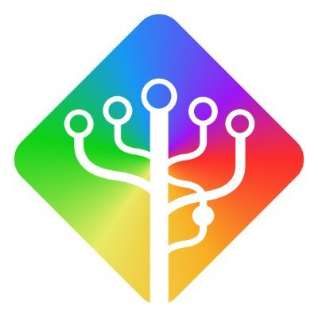
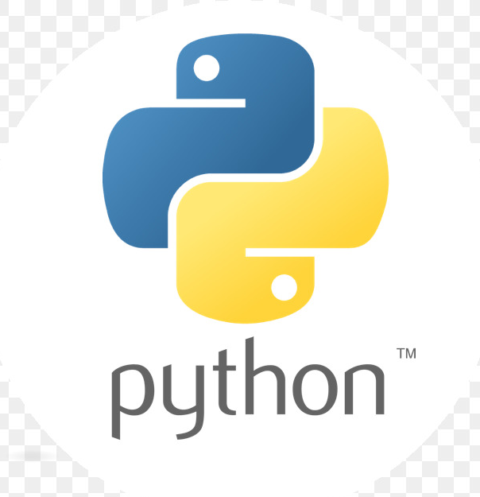
O papel de python no desenvolvimento de pipelines e sistemas distribuídos na nuvem.
Apresentador
Lucas Ramos Barbosa

Slide 2


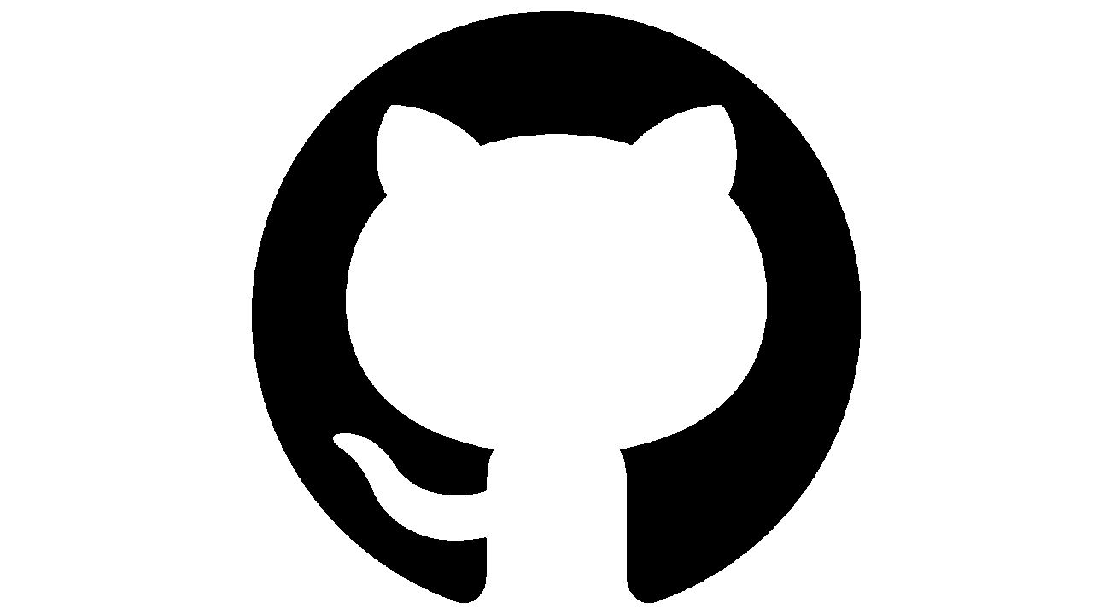
Oi, eu sou o Lucas!
Sou de Sorocaba /SP (interior de SP)
Analista e Engenheiro de dados a mais de 4 anos.
Atualmente trabalho na Wex Inc.
Sou Tecnólogo em fabricação mecânica, Técnico em Mecatrônica e estudante em engenharia da computação.
Pai de um pet, fanático por esporte a motor e por esporte em geral.
Lucas Barbosa
lucas-ramos-barbosa/
LucasRbarbosa

Slide 3
Tópicos
1
2
3
Comentar um pouco sobre pipelines
Do porque da seleção de Python
Hands-on ao final
https://github.com/LucasRBarbosa/airflow-python-demo
Notes:
Python was made by Dutch programmer Guido Van Rossum in the late 1980s. At the time, he was working on a distributed system called Amoeba at CWI, a computer science research center in the Netherlands. C was the primary language he and the other researchers used.
Van Rossum felt that programming with C was **too time consuming*8. He began to create a new language in his free time that would let him work faster. Little did he know that this side project would eventually become one of the most popular, widespread programming languages in the world.
The appeal of Python has always been its simplicity and unique mixture of C with bash script capabilities. Van Rossum drew heavily on the ABC programming language but included tools for dynamic types and imperative programming as well.
History: As Van Rossum was creating Python, he was reading the script of a popular BBC comedy series called “Monty Python’s Flying Circus”. So he decided on the name Python for his new language because it was unique and mysterious.
Python began to slowly rise in popularity after its open-source release on alt.sources. By the 1990s, Python started to win out over other similar languages like Perl and Ruby due to support by tech companies NIST and Microsoft.
Seus principais benefícios são:
Readability, English-like syntax lets you parse meaning at a glance.
Interpreted Language, easier to debug.
Dynamically Typed, Python determines types at execution. No need to declare variables and data types.
Open-Source, Python is free to use and develops quickly due to community input.

Slide 4
Pipelines e sistemas distribuídos

Slide 5
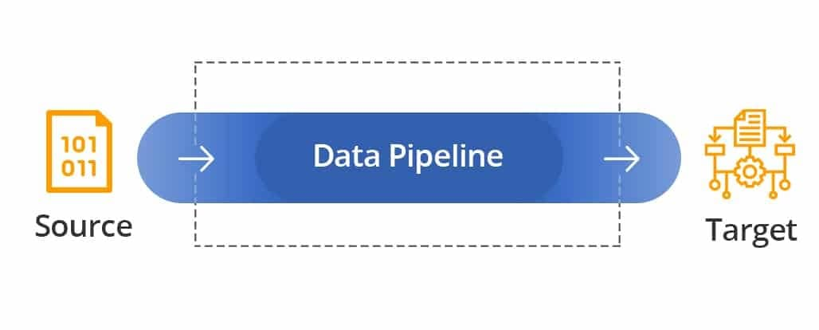
Provedor de dados
(origem)
Consumidor de dados
(destino)
Pipeline de ETL ou ELT
Armazenamento Local ou na nuvem
O Workflow c/ as etapas da tarefa
Frequencia (stream, batch)
Stack de ferramentas
Ferramenta Batch-agendamento (Airflow)
Realtime/stream (Spark, Flink, Kafka)
Linguagem(s) do seu pipeline e do seu código (IaC) e o PAC
Notes:
Batch. Batch processing is most useful for when you want to move large volumes of data at a regular interval, and you do not need to move data in real time. For example, it might be useful for integrating your Marketing data into a larger system for analysis.
Real-time. These tools are optimized to process data in real time. Real-time is useful when you are processing data from a streaming source, such as the data from financial markets or telemetry from connected devices.
Cloud native. These tools are optimized to work with cloud-based data, such as data from AWS buckets. These tools are hosted in the cloud, allowing you to save money on infrastructure and expert resources because you can rely on the infrastructure and expertise of the vendor hosting your pipeline.
Open source. These tools are most useful when you need a low-cost alternative to a commercial vendor and you have the expertise to develop or extend the tool for your purposes. Open source tools are often cheaper than their commercial counterparts, but require expertise to use the functionality because the underlying technology is publicly available and meant to be modified or extended by users.
Process as code (Pac)
https://jaxenter.com/infrastructure-as-code-platform-170465.html

Slide 6
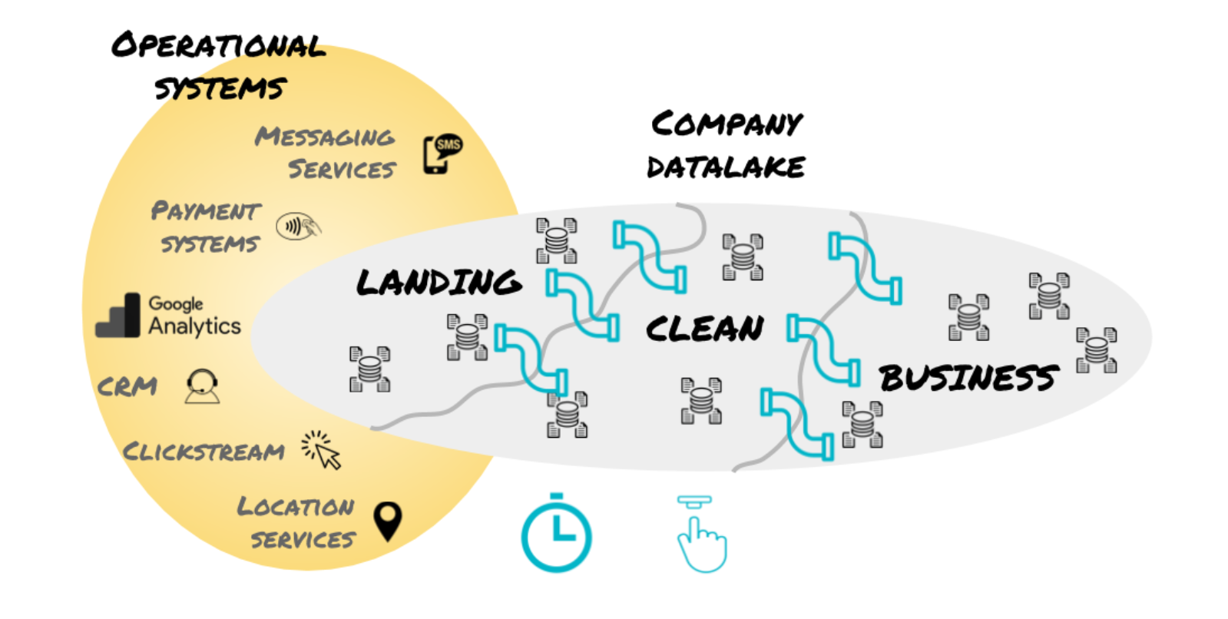
Pipelines ETL/ELT

Slide 7
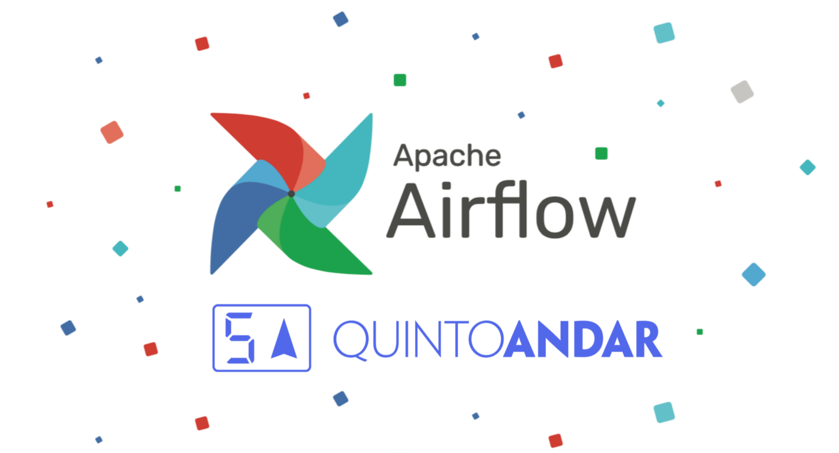
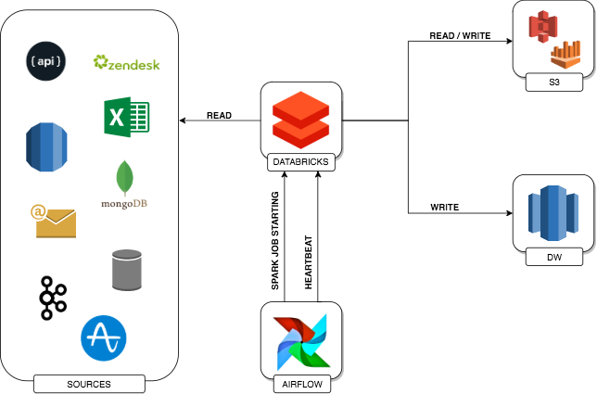
https://medium.com/quintoandar-tech-blog/how-apache-airflow-is-helping-us-to-evolve-our-data-pipeline-at-quintoandar-7d157e9f9773
Notes:
https://medium.com/quintoandar-tech-blog/how-apache-airflow-is-helping-us-to-evolve-our-data-pipeline-at-quintoandar-7d157e9f9773

Slide 8
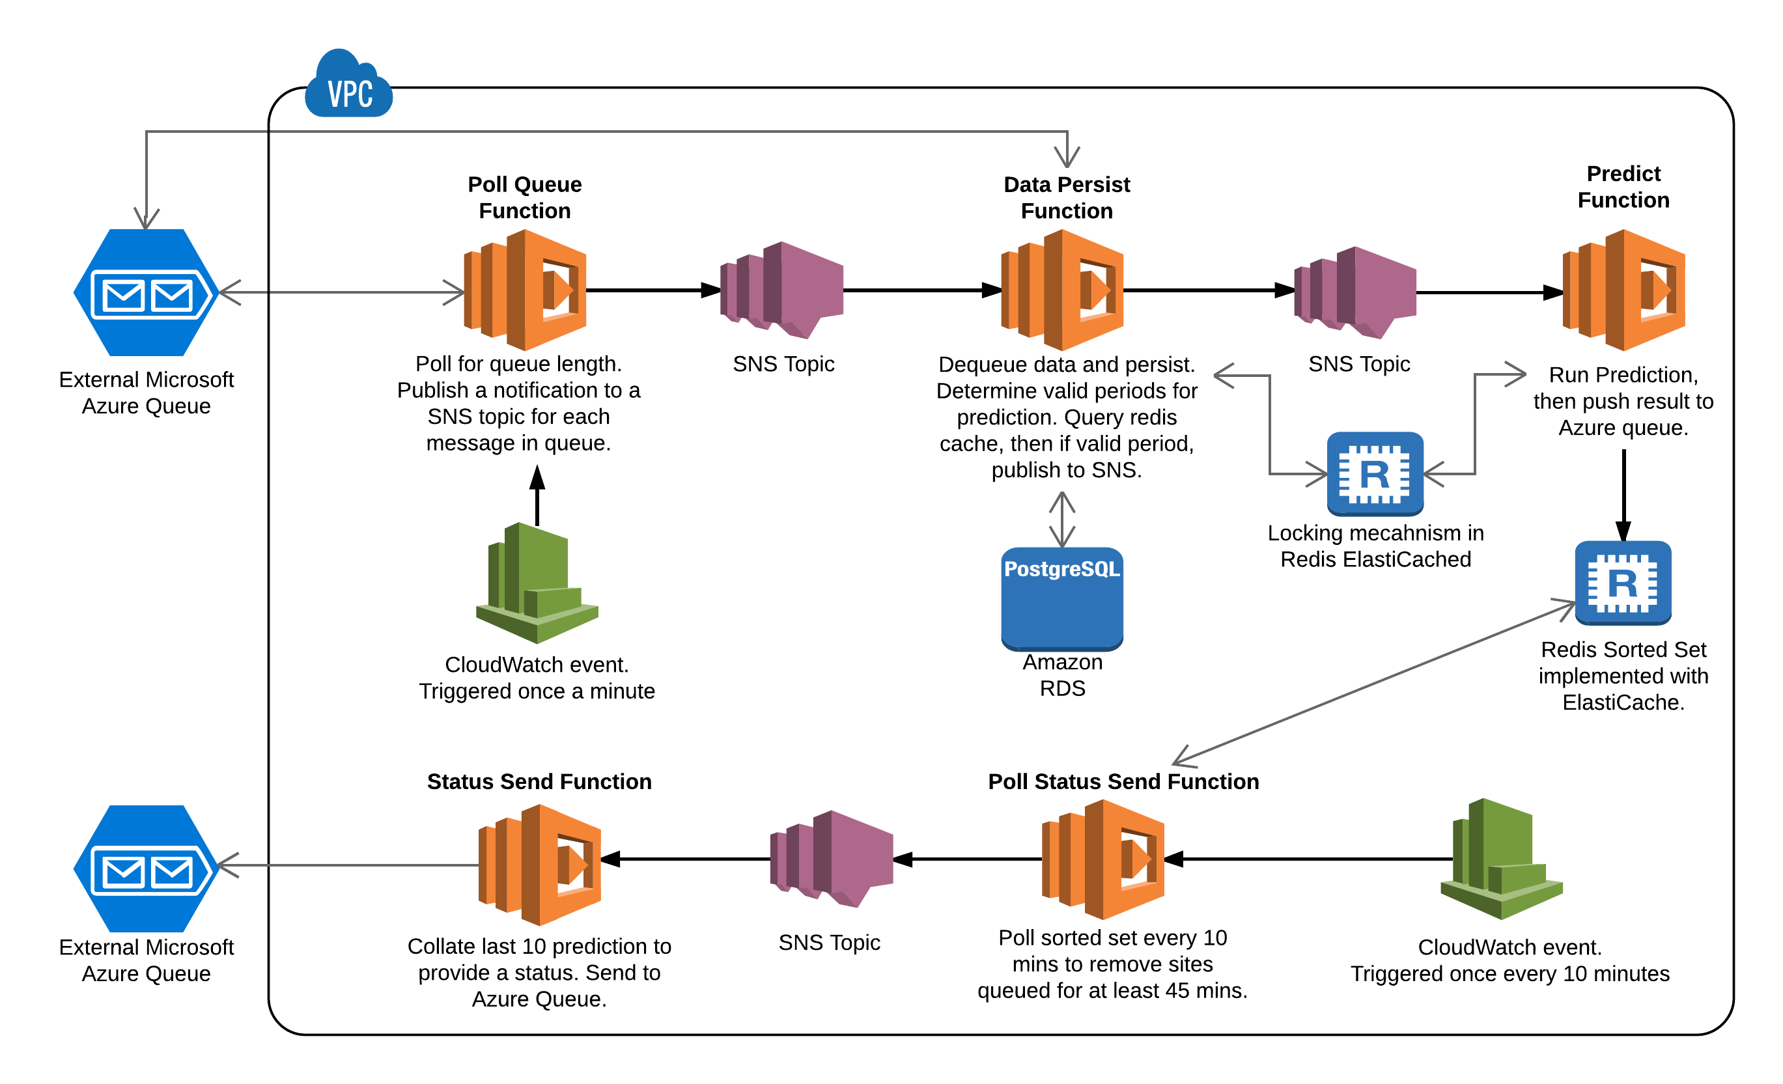
https://medium.com/@alec.hewitt9/creating-a-machine-learning-data-pipeline-in-aws-lambda-950cb2d3e62a
Notes:
https://medium.com/@alec.hewitt9/creating-a-machine-learning-data-pipeline-in-aws-lambda-950cb2d3e62a
DATA Pipelines using lambda

Slide 9
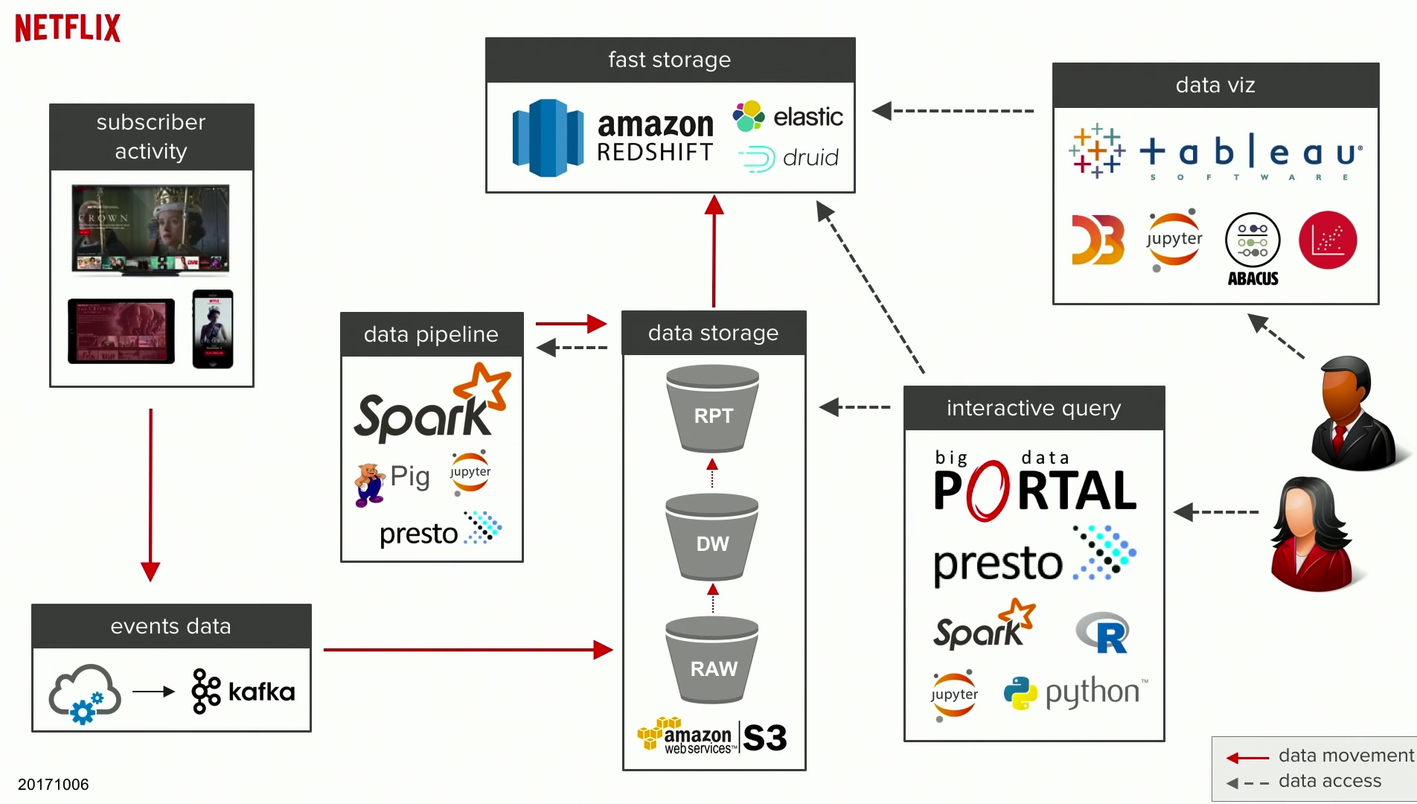
Notes:
https://www.youtube.com/watch?v=nMyuCdqzpZc&list=WL&index=2&t=211s
https://medium.com/@vikashsahu4/kafka-a-distributed-messaging-system-for-log-processing-ce62e396626c
https://www.microsoft.com/en-us/research/wp-content/uploads/2017/09/Kafka.pdf

Slide 10
Mas afinal, porque Python?
Porque que python tem todo essa relevância no desenvolvimento de pipelines hoje no mercado?

Slide 11
Python é uma linguagem de programação (ou de proposito geral) de alto nível, interpretada que também é aplicado como linguagem script. Python é uma linguagem de multiparadigma, suportando o paradigma orientado a objetos, imperativo, funcional e procedural...
Definição:
Num entendi
Notes:
Para a gente entender um pouco mais de como a linguagem chegou a esse definição e a esse formato e como que ela virou a favorita.

Slide 12

Vamos entender essa história (5min)
Curiosidades
Concebida ao final dos anos 80 pelo Pesquisador Guido Van Rossum (“Python 0.x” em 1991)
Ele criou a linguagem para ser mais simples do que outras na época e pelo tempo que essas linguagens consumiam durante a programação (Sim, estamos falando de você ”C”)
No Inicio dos anos 90 ganhou popularidade sobre outras como Pearl e Ruby devido ao suporte de empresas como NIST e Microsoft (ainda não era a favorita nessa época, mas as portas foram abertas).
Em 2018 o Van Rossum tirou “férias permanentes” de ser o “ditador permanente” de Python devido a PEP 572 , sendo agora um grupo de 5 responsável pelo desenvolvimento
O nome python não é derivado de uma família de cobras (apesar do logo ser isso), mas sim da serie de comédia “Monty Python Flying Circus”
E sim, Python é mais velho do que Java que foi criado em 1996 (Deal with it, or not....)
Esse é o cara!
Notes:
Python was made by Dutch programmer Guido Van Rossum in the late 1980s. At the time, he was working on a distributed system called Amoeba at CWI, a computer science research center in the Netherlands. C was the primary language he and the other researchers used.
Van Rossum felt that programming with C was **too time consuming*8. He began to create a new language in his free time that would let him work faster. Little did he know that this side project would eventually become one of the most popular, widespread programming languages in the world.
The appeal of Python has always been its simplicity and unique mixture of C with bash script capabilities. Van Rossum drew heavily on the ABC programming language but included tools for dynamic types and imperative programming as well.
History: As Van Rossum was creating Python, he was reading the script of a popular BBC comedy series called “Monty Python’s Flying Circus”. So he decided on the name Python for his new language because it was unique and mysterious.
Python began to slowly rise in popularity after its open-source release on alt.sources. By the 1990s, Python started to win out over other similar languages like Perl and Ruby due to support by tech companies NIST and Microsoft.
Seus principais benefícios são:
Readability, English-like syntax lets you parse meaning at a glance.
Interpreted Language, easier to debug.
Dynamically Typed, Python determines types at execution. No need to declare variables and data types.
Open-Source, Python is free to use and develops quickly due to community input.

Slide 13
Python 1
Python 2
1994
Out-2000
Python 3
Python 4
2008-atual
????
Versões do Python
Lançada com as funções lambda, map, filter, reduce
Mudanças que a permitiram se tornar mais uma linguagem como uma alternativa como uma linguagem de script
Sem definição no momento, segundo o próprio criador, “vamos ter Python 3.33 antes da 4.0”, forma de dizer
“Game changer” Pacote de correções
Alterações em sintaxe
Expansão no campo de análise de dados e Machine Learning
Notes:
Between 2012 and 2015, large technology companies like Facebook, Google, and Netflix soon expanded the field of data science and machine learning, using Python as the primary language and R for data visualization. More big-name Python tools like TensorFlow and Seaborn were developed by these companies, making Python the #1 choice for data scientists.
Note: Around 2014, Python had become one of the primary programming languages for beginners. It was even adopted by universities for CS student students and coding camps around the world.
dded the asyncho module that includes support for event loop implementations.Python 3.5
September 2015Additional support for asynchronous programming by adding awaitable objects, coroutine functions, asynchronous iteration, and asynchronous context managers.
Print passa a ser built in

Slide 14
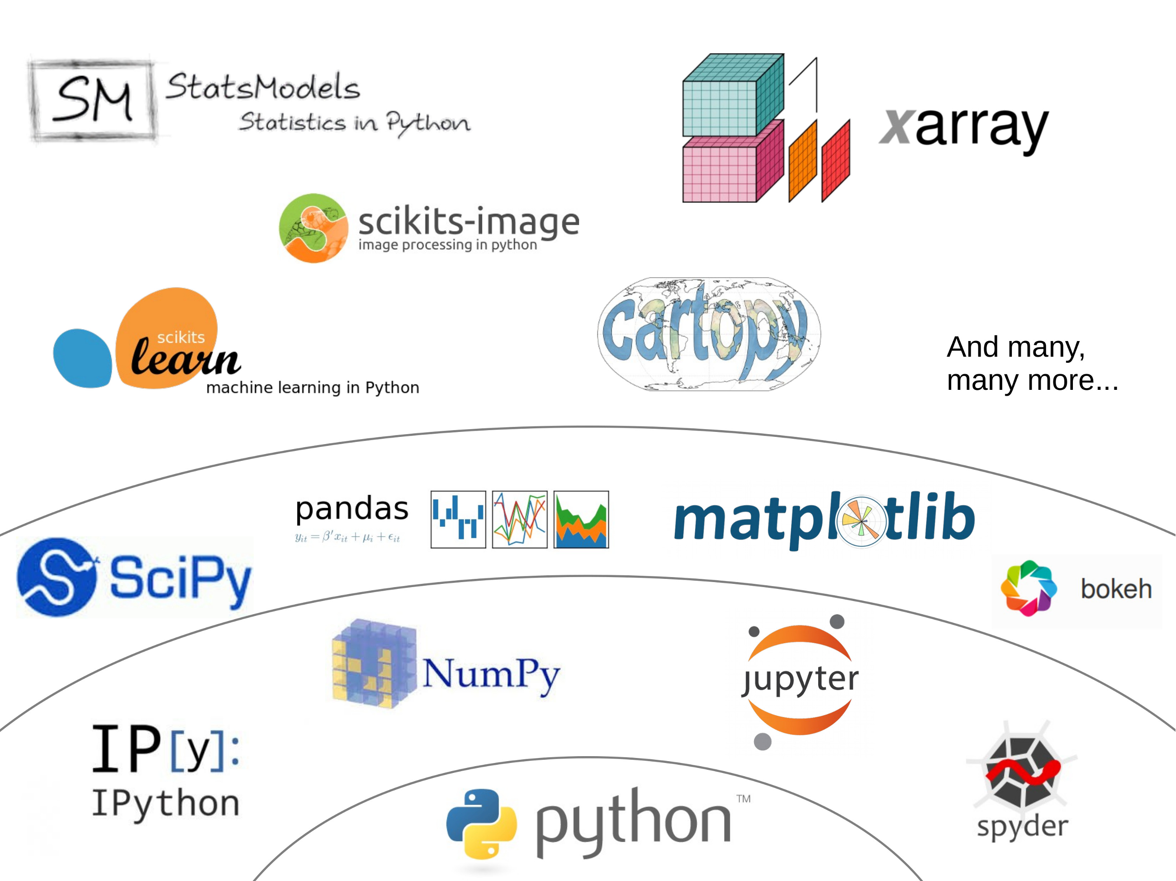
Com o surgimento do big data no início dos anos 2000, impulsionado pela crise financeira de 2008, uma nova necessidade de ferramentas de automação de dados aumentou. Muitas empresas adotaram Python por sua simplicidade e bibliotecas poderosas. Pouco depois, tornou-se a linguagem preferida para o gerenciamento de dados de mídia social.
Notes:
Python was made by Dutch programmer Guido Van Rossum in the late 1980s. At the time, he was working on a distributed system called Amoeba at CWI, a computer science research center in the Netherlands. C was the primary language he and the other researchers used.
Van Rossum felt that programming with C was **too time consuming*8. He began to create a new language in his free time that would let him work faster. Little did he know that this side project would eventually become one of the most popular, widespread programming languages in the world.
The appeal of Python has always been its simplicity and unique mixture of C with bash script capabilities. Van Rossum drew heavily on the ABC programming language but included tools for dynamic types and imperative programming as well.
History: As Van Rossum was creating Python, he was reading the script of a popular BBC comedy series called “Monty Python’s Flying Circus”. So he decided on the name Python for his new language because it was unique and mysterious.
Python began to slowly rise in popularity after its open-source release on alt.sources. By the 1990s, Python started to win out over other similar languages like Perl and Ruby due to support by tech companies NIST and Microsoft.
Seus principais benefícios são:
Readability, English-like syntax lets you parse meaning at a glance.
Interpreted Language, easier to debug.
Dynamically Typed, Python determines types at execution. No need to declare variables and data types.
Open-Source, Python is free to use and develops quickly due to community input.

Slide 15
Todo programador Python deve saber:
Todas as definições, “features” e desenvolvimento de Python são com base nos PEP’s, que significa na verdade Python Enhancement Proposal (Proposta de Melhoria do Python). O PEP 1 foi lançado alguns meses antes do Python 2.0 (em 2000)
São três tipos de PEP: Standard Tracks, Informational, Process
Alguns dos PEPs mais famosos
PEP 1 – Guideline sobre PEP (2000)
PEP 8 – Guia de estilo e formatação código Python
PEP 387 – Politica de Retro compatibilidade (2009*)
PEP 20 – The Zen of Python
------------- Zen of Python ------------- Bonito é melhor que feio. Explícito é melhor que implícito. Simples é melhor que complexo. Complexo é melhor que complicado. Linear é melhor do que aninhado. Esparso é melhor que denso. Legibilidade conta.
#teste isso no seu interpretador
Import this
Notes:
Python was made by Dutch programmer Guido Van Rossum in the late 1980s. At the time, he was working on a distributed system called Amoeba at CWI, a computer science research center in the Netherlands. C was the primary language he and the other researchers used.
Van Rossum felt that programming with C was **too time consuming*8. He began to create a new language in his free time that would let him work faster. Little did he know that this side project would eventually become one of the most popular, widespread programming languages in the world.
The appeal of Python has always been its simplicity and unique mixture of C with bash script capabilities. Van Rossum drew heavily on the ABC programming language but included tools for dynamic types and imperative programming as well.
History: As Van Rossum was creating Python, he was reading the script of a popular BBC comedy series called “Monty Python’s Flying Circus”. So he decided on the name Python for his new language because it was unique and mysterious.
Python began to slowly rise in popularity after its open-source release on alt.sources. By the 1990s, Python started to win out over other similar languages like Perl and Ruby due to support by tech companies NIST and Microsoft.
Seus principais benefícios são:
Readability, English-like syntax lets you parse meaning at a glance.
Interpreted Language, easier to debug.
Dynamically Typed, Python determines types at execution. No need to declare variables and data types.
Open-Source, Python is free to use and develops quickly due to community input.

Slide 16
Do ponto de vista profissional
Analista de Dados
Engenheiro de Dados
Cientista de Dados

Slide 17
Novamente... porque Python?
Não tem segredo. Porque em geral Python é uma linguagem mais acessível para programar, possibilitando mesmo aqueles que não tenham um background extremamente técnico de desenvolver um pipeline decente, atendendo muito os requisitos das empresas.

Slide 18
Hands-on
Agora vamos montar um pipeline básico.

Slide 19
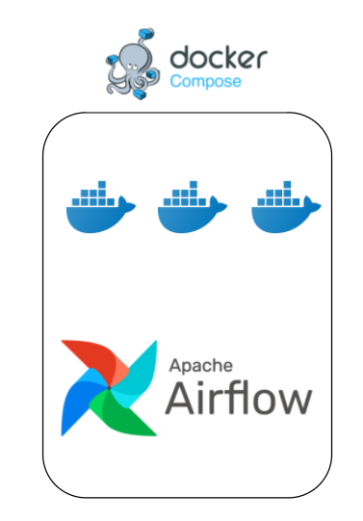
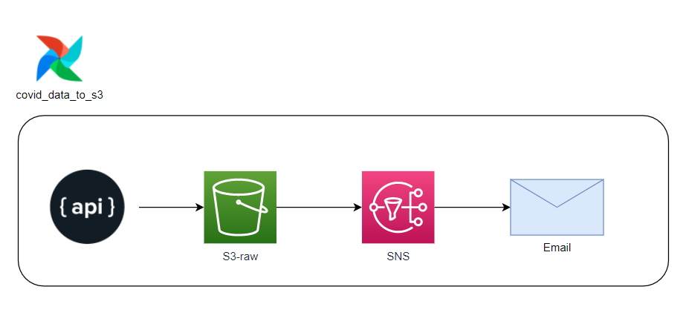
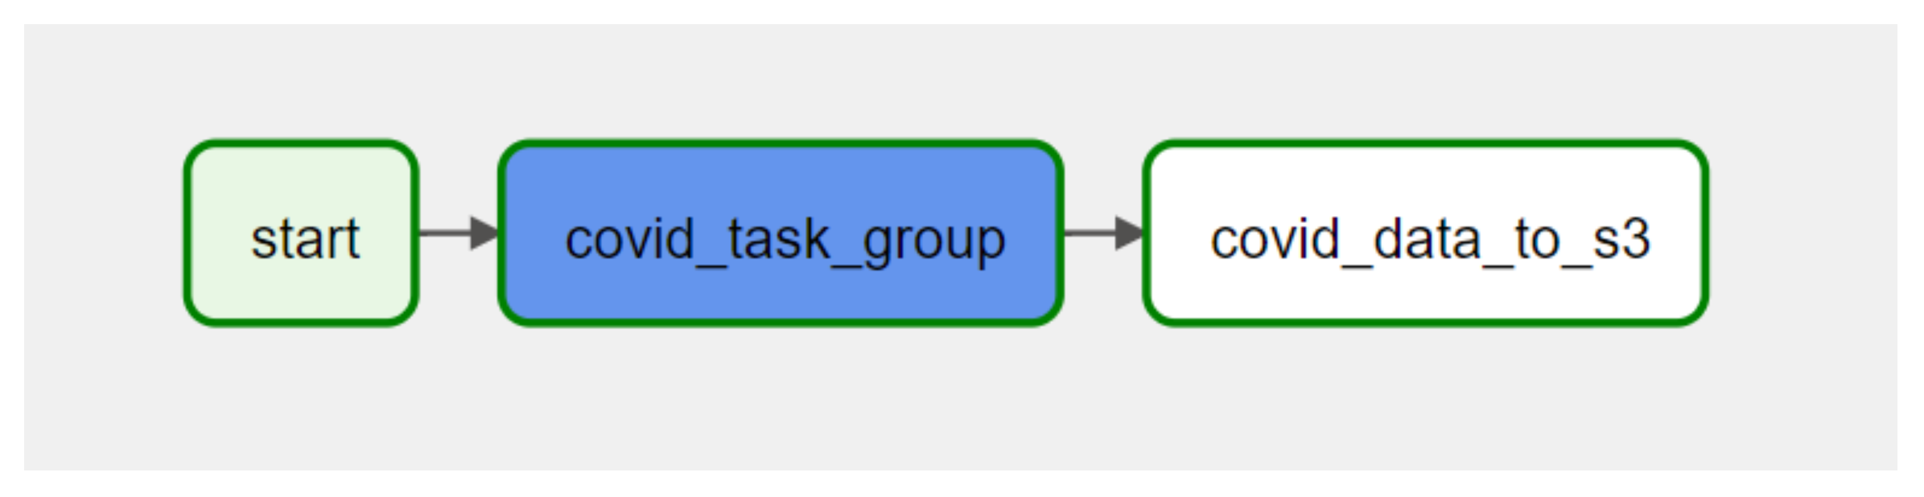
No Airflow, uma DAG – ou Directed Acyclic Graph –is a collection of all the tasks you want to run, organized in a way that reflects their relationships and dependencies.

Slide 20
# Dúvidas?
from publico import perguntas

